Slide 1
ANN for Concrete Strength prediction

Slide 2
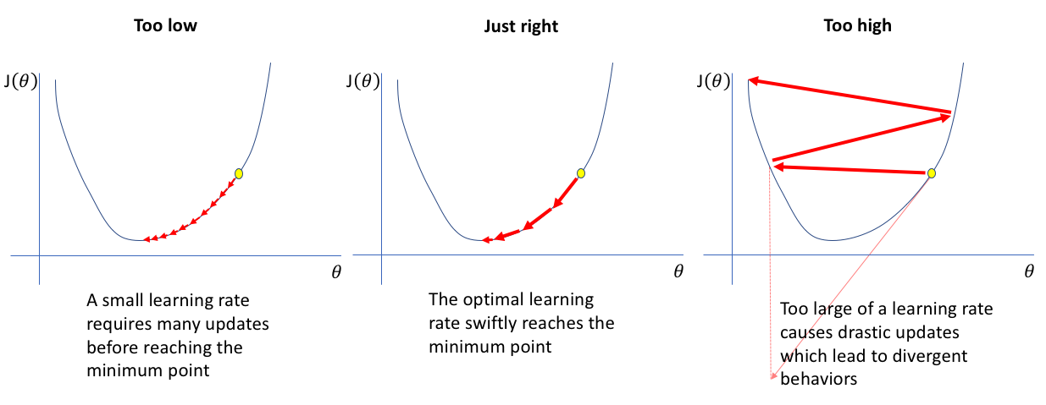
Learning Rate

Slide 3
Learning Rate
R-squared |  | Threshold for stopping (loss value)
 |  | 1.00E-03 | 1.00E-04 | 1.00E-05 | 1.00E-06 | 1.00E-07 | 1.00E-08 | 1.00E-09
Threshold for adjusting LR (loss value) | 1.00E-02 | 0.6935 | 0.6956 | 0.699 | 0.7006 | 0.6991 | 0.698 | 0.6999
 | 1.00E-03 |  | 0.7013 | 0.7006 | 0.7009 | 0.698 | 0.6981 | 0.7026
 | 1.00E-04 |  |  | 0.7004 | 0.7024 | 0.7032 | 0.7005 | 0.7029
 | 1.00E-05 |  |  |  | 0.7032 | 0.6988 | 0.69623 | 0.7034
 | 1.00E-06 |  |  |  |  | 0.7003 | 0.7014 | 0.7035
 | 1.00E-07 |  |  |  |  |  | 0.7007 | 0.7043
 | 1.00E-08 |  |  |  |  |  |  | 0.7034

Slide 4
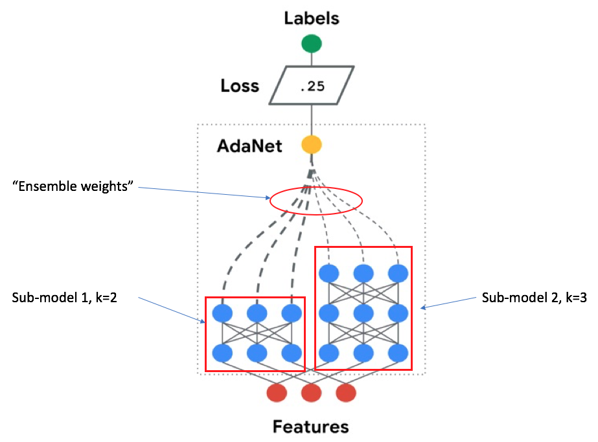
Adaptive Structural Learning (AdaNet)
Ensemble of several subnetworks
Include a candidate subnetwork only when it improves the ensemble’s training loss
https://ai.googleblog.com/2018/10/introducing-adanet-fast-and-flexible.html

